Slide 1
Network Access Control Systems at Educational Institutions
Richard Becker
Brian Leslie
Kansas State University

Slide 2
Definition of “NAC,” Network Access Control
Authentication. (Allows users/devices access based on credentials or device type.)
End-point security. (Device is responsible for its own security.)
Access Control. (Differentiating access.)

Slide 3
Kansas State has provided NAC for campus residents for the last six years, placing it ahead of many peer institutions.

Slide 4
Special NAC criteria at an educational institution:
Network environment is implicitly somewhat insecure.
Extremely heterogeneous pool of computers and devices.
“False negatives” (devices that fail NAC tests and are blocked) lead to users reacting very impatiently; “false positives” (devices improperly passed through) are relatively harmless.

Slide 5
General criteria for choosing a NAC solution:
Long-term viability and continued focus of vendor.
Interoperability with existing equipment.
Pricing structure.
Ease of implementation.
Getting accurate customer feedback (not necessarily from vendor’s sales team!).

Slide 6
General criteria for choosing a NAC solution (continued):
Granularity of control.
Scalability. (To network load, and to different areas of enterprise.)
Ambitiousness of control. (E.g., does NAC use VLAN’s to control access.)
Fail-state (in-line or out-of-line?).

Slide 7
General criteria for choosing a NAC solution (continued):
Detection of rogue devices (especially NAT-ed).
Ease of creating custom policies.
Easy, intuitive remediation. (Does user get clear instructions?)

Slide 8
In general, our experience is that choosing between multiple NAC solutions is extremely difficult and time-consuming.
"The products bear very little similarity to one another... There's no such thing as 'best of breed' in NAC, because for the 12 vendors we evaluated, there are nearly 12 different 'breeds' of NAC product. " (Network World, 5-24-2010)

Slide 9
Bradford vs. Impulse
In-line and out-of-line
Network topology requirements
Knowledge of edge devices
Fundamentals of operation
Support of NAC hardware

Slide 10
In-line vs. Out-of-line
Implications
Failure modes
Bradford implemented with HA pair
Impulse fails, allowing traffic
Performance
Hardware requirements
Scalability

Slide 11
Network Topology
Bradford
Can be installed “anywhere” on the network
Must be able to receive SNMP traps and access network devices via SSH
Management and enforcement pair
Enforcement at layer 2
Handles DHCP/DNS for Registration, Remediation, and Quarantine vlans
Recommended numbers of active clients

Slide 13
Network Topology
Impulse SafeConnect
Needs to be routed by device for which it is providing enforcement
If Nat’ing is in use, it must be outside of enforcement scope
Requires use of netflow
Hardware support
Can be a single enforcer or multiple enforcers
Enforcement at layer 3

Slide 15
Knowledge of Edge Devices
Bradford
Must have control of edge network devices
Dependency on supported devices
Configuration management
Syncing vlans and switch port status
Misconfigured ports and enforcement
What about unmanaged switches, hubs?

Slide 16
Knowledge of Edge Devices
Impulse SafeConnect
“Doesn’t care” what edge device is
NAT’ing implications

Slide 17
Fundamentals of Operation
Bradford
Operates at layer 2
Handles DHCP and DNS for Registration, Remediation, and Quarantine vlans
Receives SNMP traps as clients attach, or radius requests for wireless
Uses SSH to network devices for enforcement
Persistent Agent vs. Run-once
Policy enforcement and scheduled scans

Slide 18
Fundamentals of Operation
Impulse SafeConnect
Operates at layer 3
Uses netflow exports from router for client detection
Uses policy-based routing for enforcement
Policy key vs. Non-policy key devices
Policy enforcement constantly

Slide 19
Support of NAC Hardware
Bradford
Most support falls on IT staff
Configuration backups
Monitoring system health
Hardware replacement / upgrades
On-line community support
Tech support available to work through issues
Software upgrades

Slide 20
Support of NAC Hardware
Impulse SafeConnect
Managed service
System monitoring
Impulse backs up configurations
Device replacement
Software upgrades
Tech support covered by maintenance

Slide 21
Kansas State's implementation of SafeConnect is based on these criteria:
Windows Computers
User Authentication (eID, eID password)
Windows Updates/Install Automatically - turned on, pointed to WSUS server
Campus antivirus (Trend Micro) turned on, definitions up-to-date
Windows Firewall turned on
Peer-to-Peer Detection

Slide 22
Kansas State's implementation of SafeConnect is based on these criteria:
Apple Computers
User authentication
Campus antivirus (Trend Micro) turned on, definitions up-to-date
OS X ver.10.5 or higher

Slide 23
Kansas State's implementation of SafeConnect is based on these criteria:
Linux Computers
(No compatible NAC agent software.)
User authentication

Slide 24
Kansas State's implementation of SafeConnect is based on these criteria:
Mobile Devices (browser based)
User authentication
Misc. devices (Set-top media
streamers, HDTV's, VOIP, etc.)
No checks; should be auto-detected. May require "manual pass" by help desk if device is not recognized.

Slide 25
SafeConnect may seem – and is! – simplistic.
Their philosophy is to check enough to maintain adequate security, but not to be over-ambitious.

Slide 26
Ways to Subvert SafeConnect:
User agent string.
Flashing MAC address.
NATing behind Linux.
Removing policy key.
Using guest network.

Slide 27
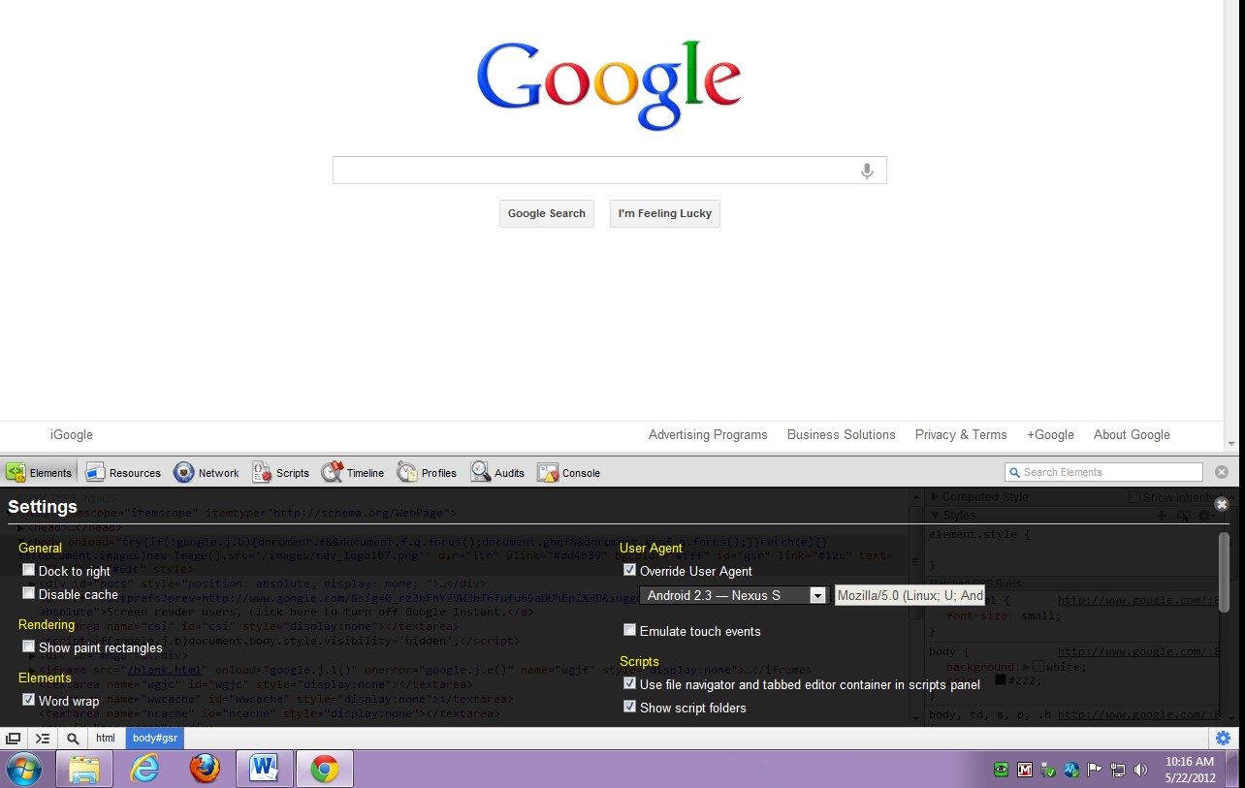
The most problematic of these, changing the user agent, takes 10 seconds in Chrome and Mozilla.

Slide 28
SafeConnect’s stated philosophy is that “we worry about the 99% of users, rather than exerting maximum effort on the top 1%.”
This makes sense, considering…

Slide 29
In broad terms, this user is more of a threat than a technically sophisticated user.

Slide 30
Summarizing – Can We Recommend SafeConnect?

Slide 31
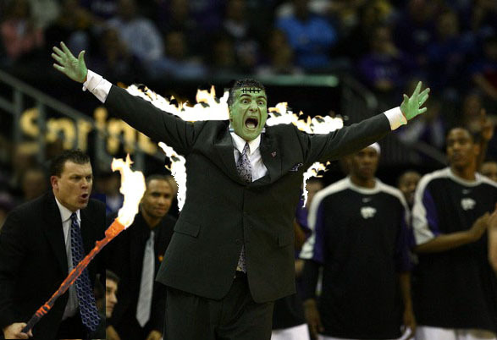
We have enough excitement at K-State without the network blowing up…

Slide 32
Please contact us for questions or feedback.
Richard Becker
rlb@k-state.edu
Brian Leslie
bdleslie@k-state.edu

